Slide 1

Medical Murder is the #1 Cause of Death in the U.S. – By Design (People Are Too Expensive – Satan’s Big Lie)
Where? Mystery Babylon

Slide 2
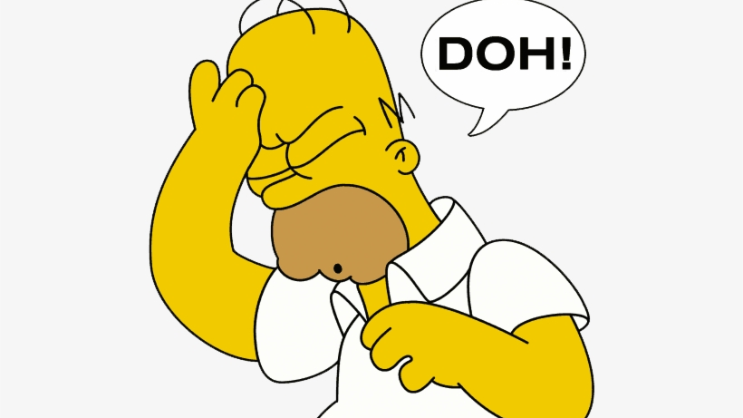
We’ve been programmed to believe lies – from all sides and angles

Slide 3
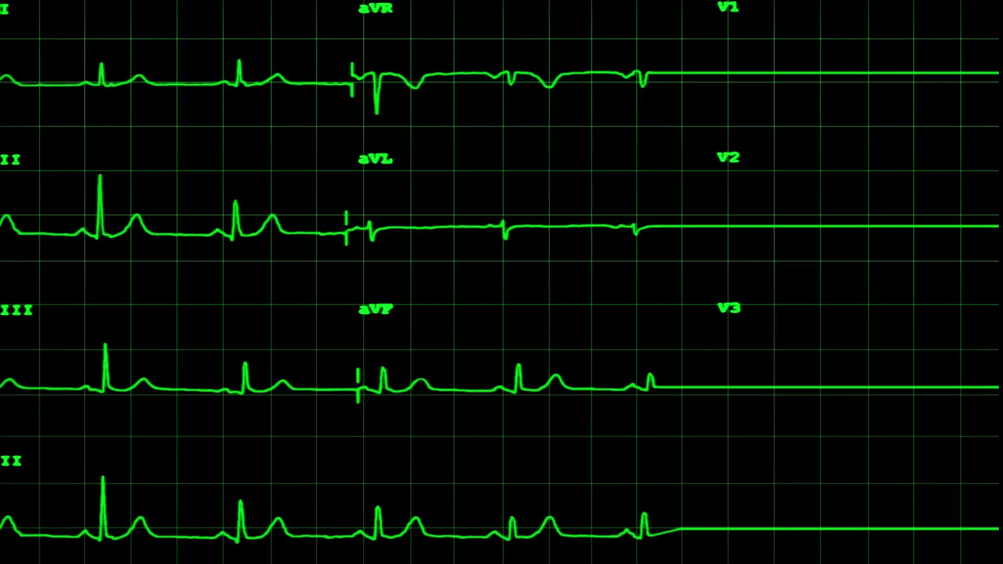
Facts:
Historical facts – pre-COVID
Annual deaths: 700K heart disease; 600K cancer; 400K medical “malpractice” (3rd leading cause of death)
https://www.statnews.com/2021/08/04/medical-errors-accidents-ongoing-preventable-health-threat/#:~:text=Injury%20or%20illness%20caused%20by,under%20wraps%20%E2%80%94%20and%20they%20are
Current facts – COVID Era and Post COVID
All cause mortality increase of 24% in vaccinated
https://www.israelnationalnews.com/news/317091
All cause mortality cumulative increase since January 2020 – weekly graph
https://ourworldindata.org/grapher/cumulative-excess-mortality-p-scores-projected-baseline?tab=chart&facet=none&country=~USA

Slide 4


Could the U.S. be Mystery Babylon?

Slide 5
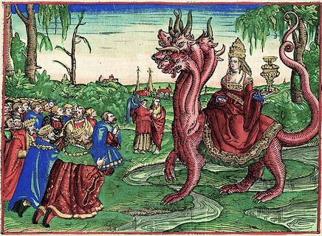
Revelation 17 speaks of this place…
Revelation 17:1-2 tells us, “Then one of the seven angels who had the seven bowls came and talked with me, saying to me, ‘Come, I will show you the judgment of the great harlot who sits on many waters, with whom the kings of the earth committed fornication (Bohemian Grove), and the inhabitants of the earth were made drunk with the wine of her fornication.’”
Revelation 17:5 goes on to say, “And on her forehead a name was written: MYSTERY, BABYLON THE GREAT, THE MOTHER OF HARLOTS AND OF THE ABOMINATIONS OF THE EARTH.”

Slide 6


Revelation 18:23
Revelation 18:23: And the light of a lamp will never shine in you again! And the sound of a bridegroom and bride will never be heard in you again! For your merchants were the most important people of the earth, because with your sorcery they deceived all the nations.
God is judging the use of sorcery in Revelation Chapter 9 to get the church to repent: https://www.youtube.com/watch?v=Rk9BAQ7bDwQ

Slide 7
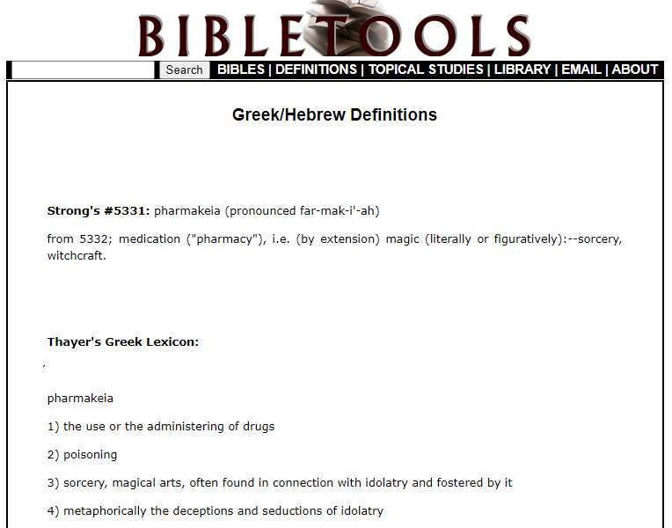
Sorcery comes from the Greek word ‘Pharmakeia’

Slide 8

Is God’s judgment of Israel happening again; is Israel a type of America? https://www.youtube.com/watch?v=zJoK5wngEL0
Do we deserve His judgment?
https://www.youtube.com/watch?v=zJoK5wngEL0

Slide 9


Q: Why would the leaders of the U.S. want to take it down?
A: By design.
https://www.youtube.com/watch?v=wLFGRTg4vVg
https://www.youtube.com/watch?v=GuPZ5nAFjVc

Slide 10
Conclusion: America is the center of evil, by design.

Slide 11

Has medicine become an idol in the U.S.?

Slide 12

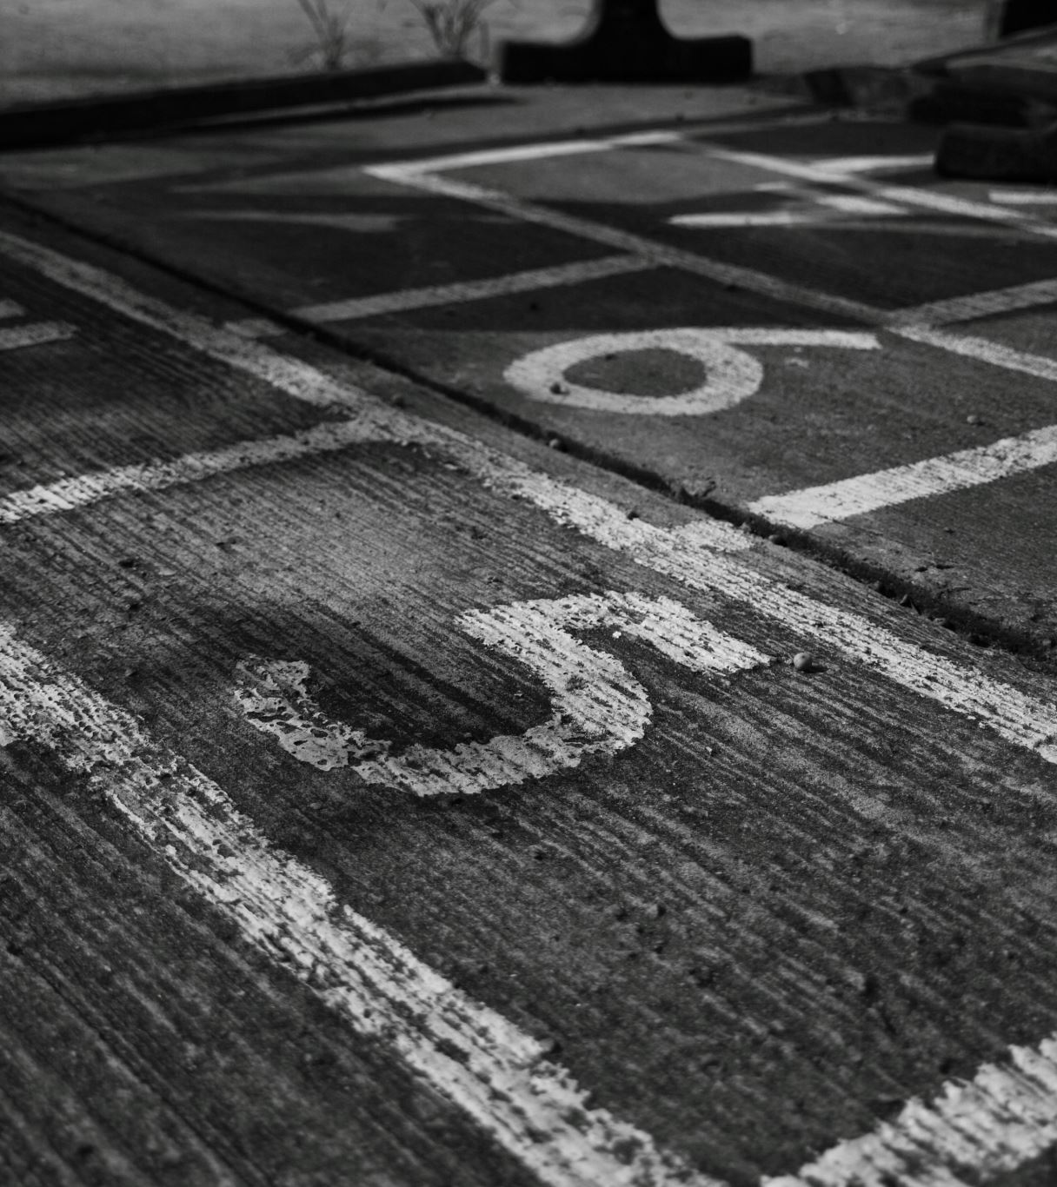


How did it start?
https://plandemicseries.com/plandemic-2-indoctornation/

Slide 13
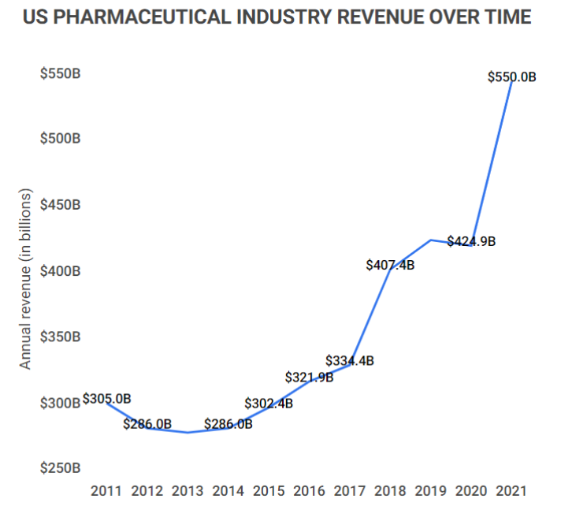
Where has it gone? https://plandemicseries.com/plandemic-2-indoctornation/
There were about 4.73 billion prescriptions dispensed in the U.S. in 2022
The U.S. pharmaceutical industry makes up 43.7% of the global pharmaceutical market in 2023.
The U.S. has only 4.2% of the worlds’ population.

Slide 14
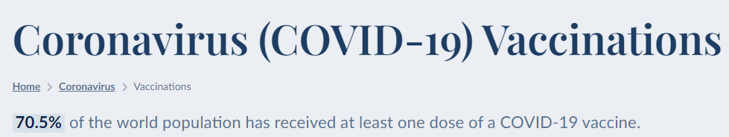

We have a vaccine culture – anything but God
Worldwide jab numbers (as of 9/26/23)
Another push – from 9/15/23 https://www.youtube.com/watch?v=Q0oIhnuNy2c

Slide 15
The Truth – the Brook Jackson FCA Lawsuit
Pfizer’s defense was that the government knew there were no clinical trials so they could not defraud the government, and the government reinforced that defense. Pfizer produced an Other Transaction Authority (OTA) contract in its defense. This means the Department of Defense (DOD) was paying for the manufacture of a large-scale prototype, eliminating public protections and creating no accountability by Pfizer. Pfizer was given authority to create a prototype, not a vaccine, as a countermeasure/bioweapon under a military contract.
Case 1:21-cv-00008-MJT Document 96 Filed 03/31/23 Page 41 of 48 PageID #: 2335: Absent from the Amended Complaint, however, are factual allegations indicating that the alleged violations at the Ventavia sites resulted in the FDA receiving fabricated, inaccurate, or misleading data about the safety or efficacy of the vaccine
August 25, 2023 letter from Pfizer attorney to judge, because Brook Jackson continues to speak out (page 4): “As the above facts show, the Government’s approval, payment, and support for the safety and efficacy of the COVID-19 vaccine has been consistent during both the Biden and Trump Administrations. Both administrations have rejected Relator’s false assertions that the vaccine is unsafe and ineffective. And most significantly for this case, both administrations have continued to contract for, approve, and pay for the vaccine with full knowledge of Relator’s allegations.” Why don’t they sue her for defamation???

Slide 16
Conclusion: Medicine is an idol on the tree of knowledge Satanic dialectic. The white coats have been programmed and we’ve been programmed to obey the white coats. The idol which we thought was to help us, was designed to kill us. The love of money facilitates all sorts of evil.

Slide 17

How is the population blinded to what is happening?

Slide 18

Our sin nature means history repeats itself, without God https://plandemicseries.com/plandemic-2-indoctornation/

Slide 19
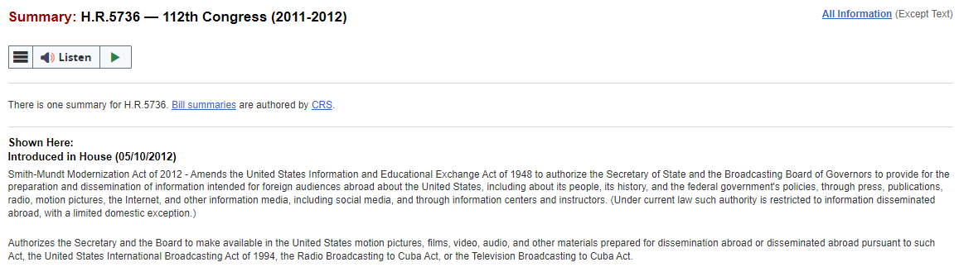
Propaganda: Legalized in 2012

Slide 20
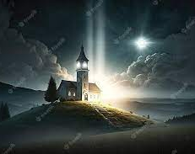
7/18/23 NewsMax https://www.newsmaxtv.com/Shows/Chris-Plante-Right-Squad/vid/1_eww9zsjv
Projecting our sin on others is an attempt to keep us believing we are the ‘light on the hill’

Slide 21

The results of blindness – a barrier to the truth is thinking you already have it Meme clip https://media.gab.com/system/media_attachments/files/116/895/465/playable/bcfe67a165e6348c.mp4?utm_source=substack&utm_medium=email

Slide 22
Conclusion: By design, critical thinking has been trained out of the public fool system. Propaganda fills the void and is used to influence our thinking 24/7. Without God, we are literally blind to the Truth.

Slide 23

Once the idol has a foothold…

Slide 24
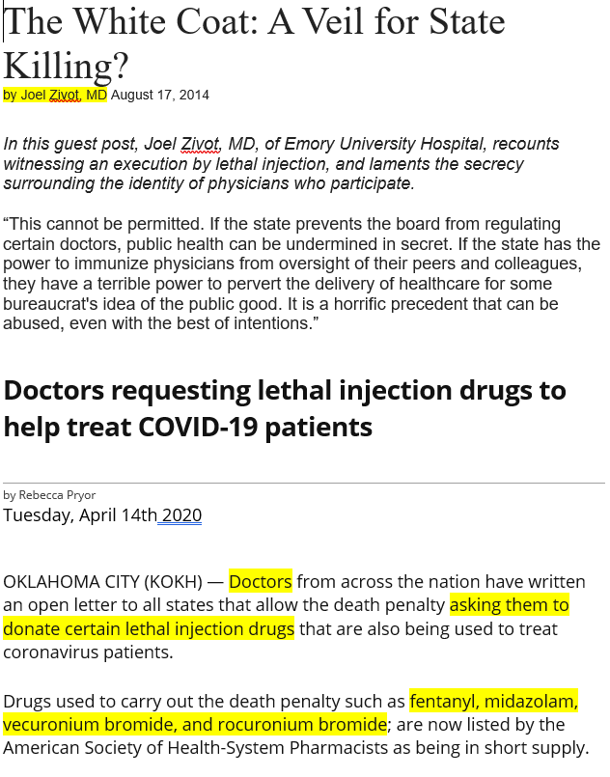
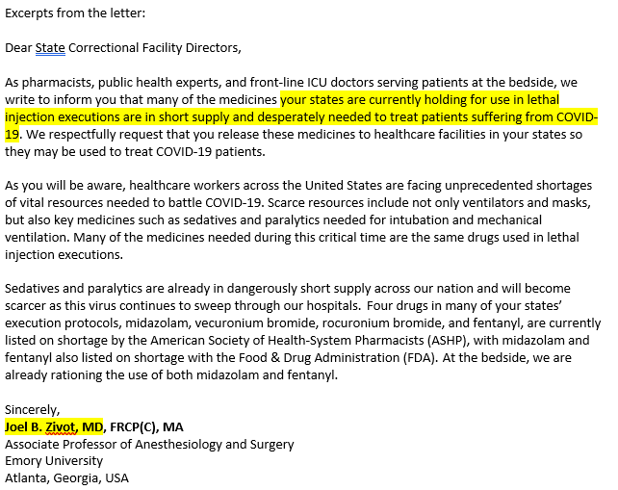
In the United States of America?

Slide 25
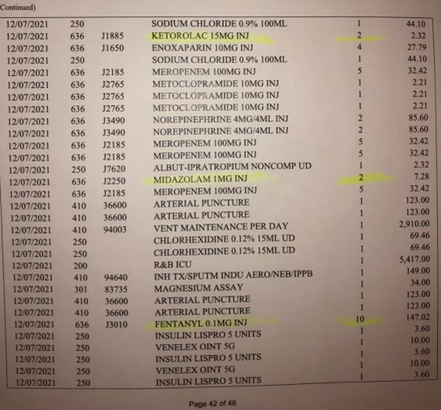
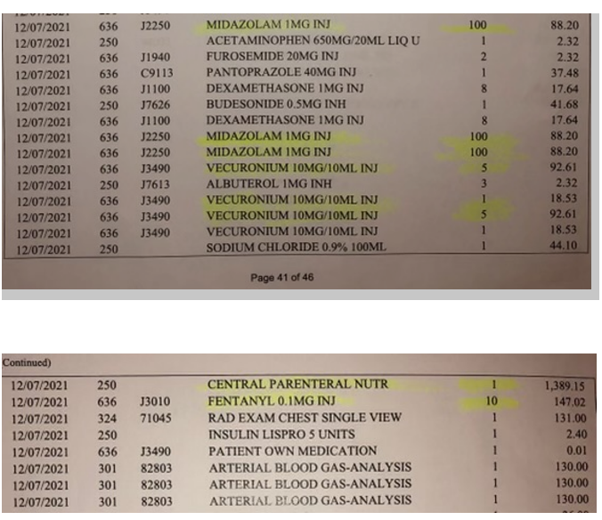
YES!

Slide 26
Conclusion: The United States is in first place in the race to replace God.

Slide 27
Medical Murder is the #1 Cause of Death in the U.S. – By Design (People Are Too Expensive – Satan’s Big Lie) Up Next…
Why? The Esoteric Spiritual Battle

